Slide 1

ICE 3161
COMMUNICATION ENGINEERING
Dr. Asif Zaman
Professor, CSE, RU

Slide 2
Satellite Networks?
Def^{n}: an artificial body placed in orbit round the earth or moon or another planet in order to collect information or for communication
A satellite network is a combination of nodes, some of which are satellites, that provides communication from one point on the Earth to another.
A node in the network can be:
a satellite,
an Earth station, or
an end-user terminal or telephone.

Slide 3
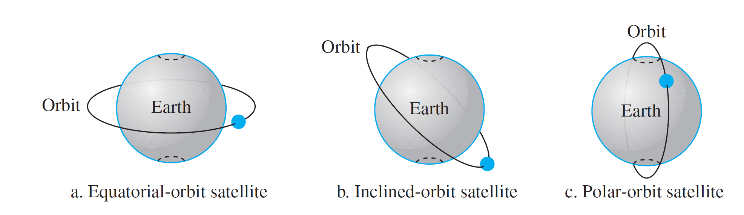
Operation
Orbits: the path that a satellite takes around a planet or other star
নিরক্ষীয়
ঢাল- incline.
The period of a satellite, the time required for a satellite to make a complete trip around the Earth,
is determined by Kepler’s law
Notes:
নিরক্ষীয় equatorial
ঢাল- incline.

Slide 4
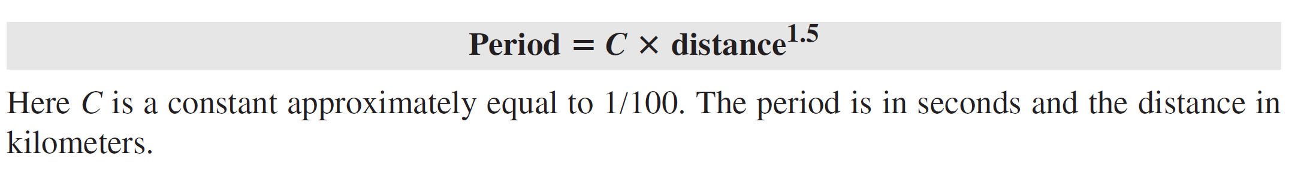
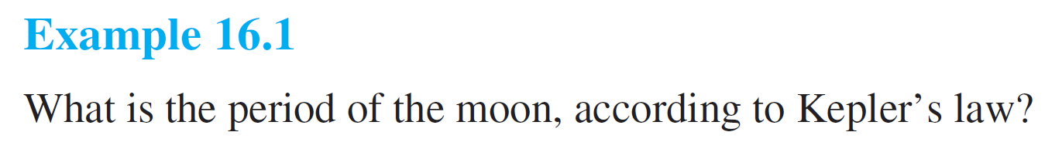
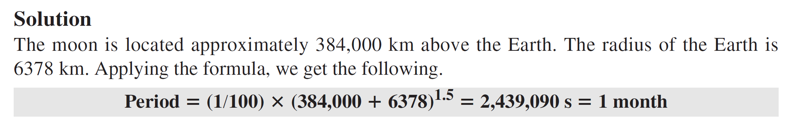

Slide 5
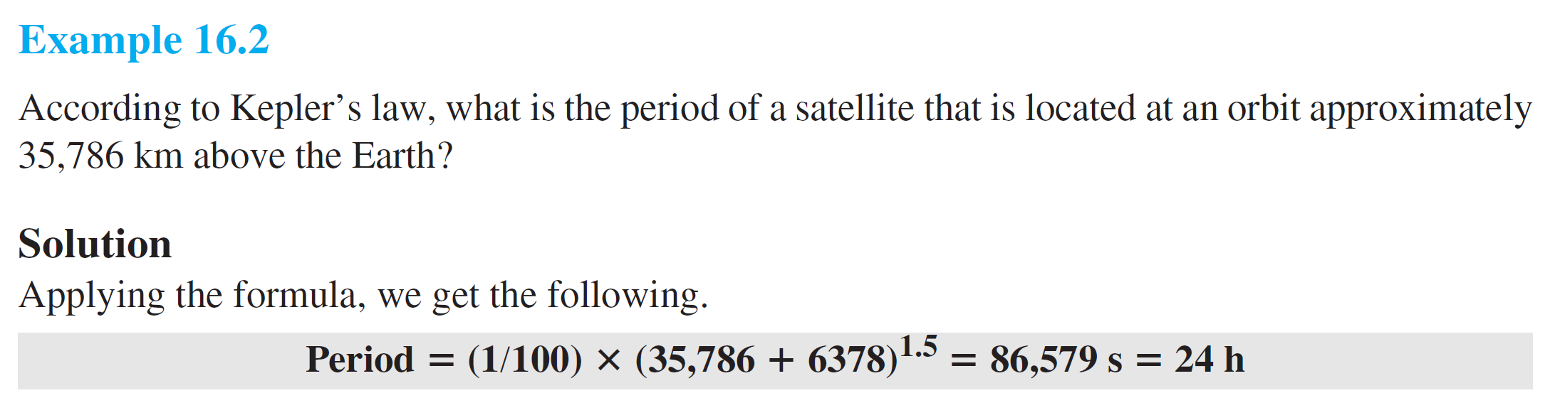

Slide 6
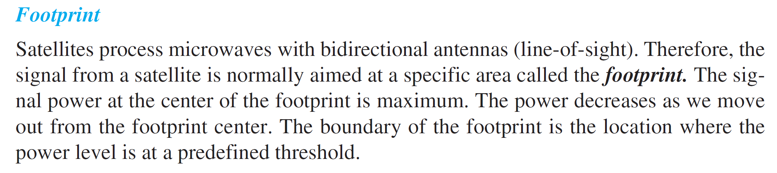
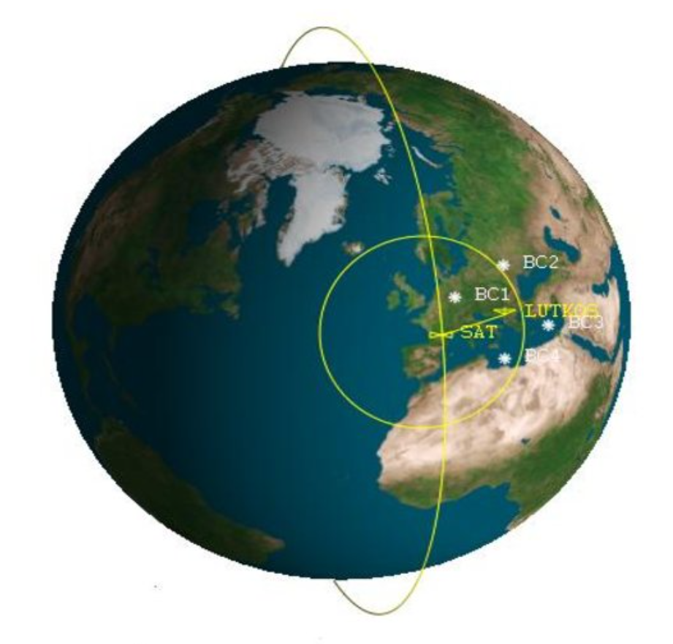
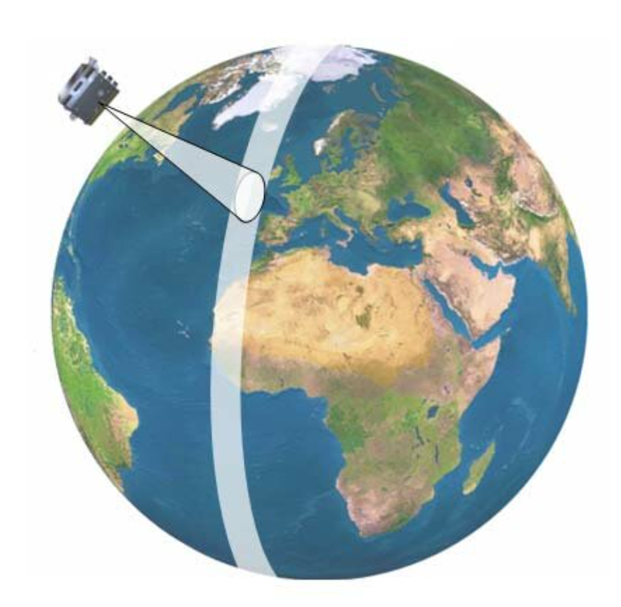

Slide 7
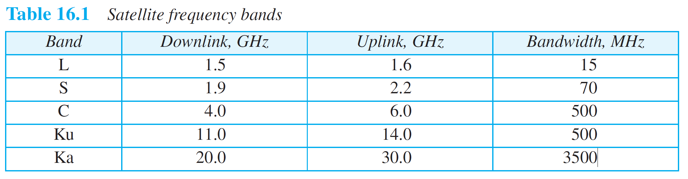
The frequencies reserved for satellite microwave communication are in the gigahertz (GHz) range.
Each satellite sends and receives over two different bands.
Transmission from the Earth to the satellite is called the uplink.
Transmission from the satellite to the Earth is called the downlink.

Slide 8
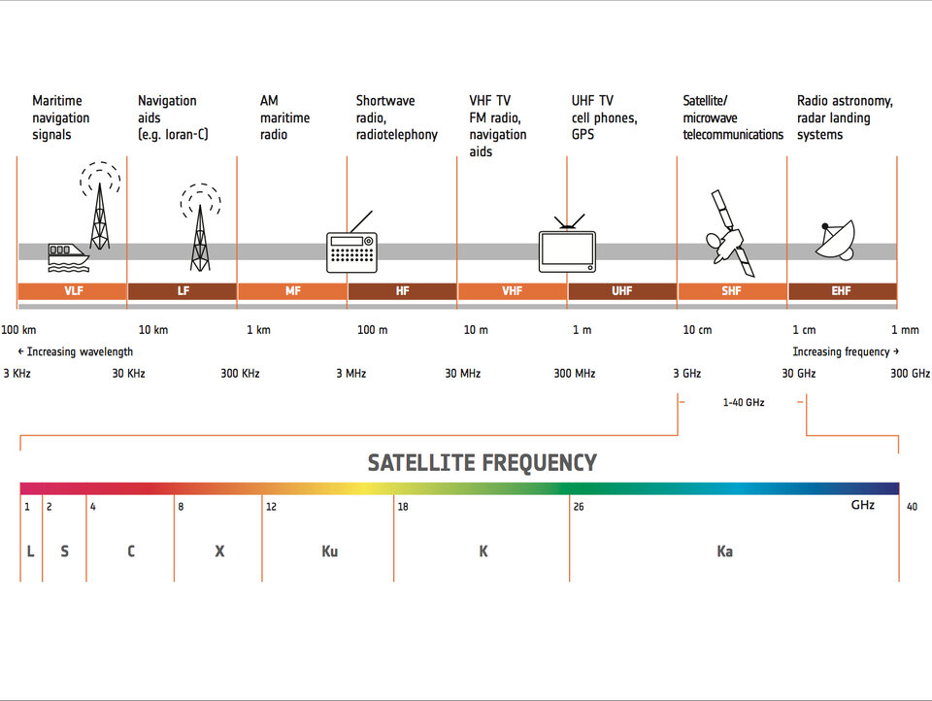
https://www.esa.int/Applications/Connectivity_and_Secure_Communications/Satellite_frequency_bands

Slide 9
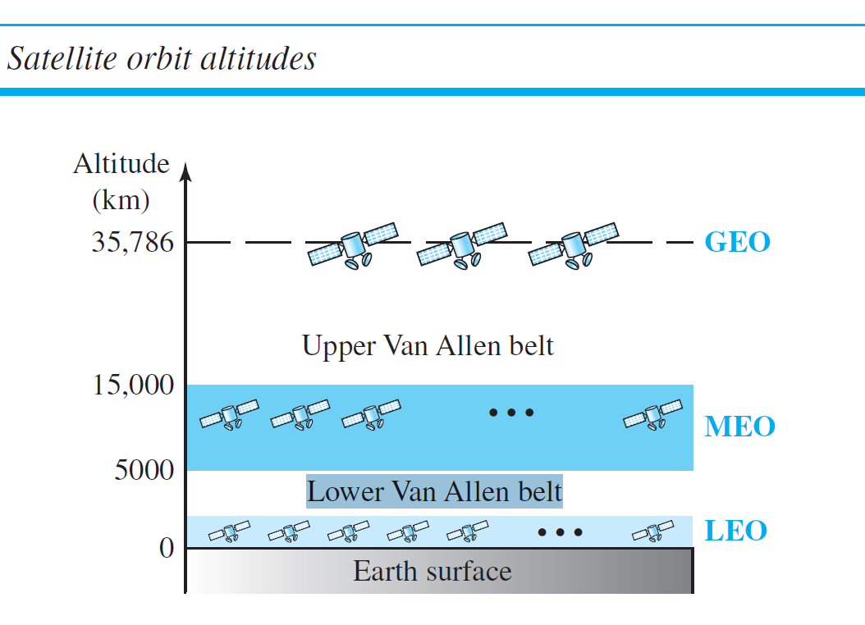
Three Categories of Satellites
There is only one orbit, at an altitude of 35,786 km, for the GEO satellite.
MEO satellites
are located at altitudes between 5000 and 15,000 km
LEO satellites are normally
below an altitude of 2000 km
Geostationary Earth orbit (GEO),
low-Earth-orbit (LEO), and
medium-Earth-orbit (MEO).

Slide 10
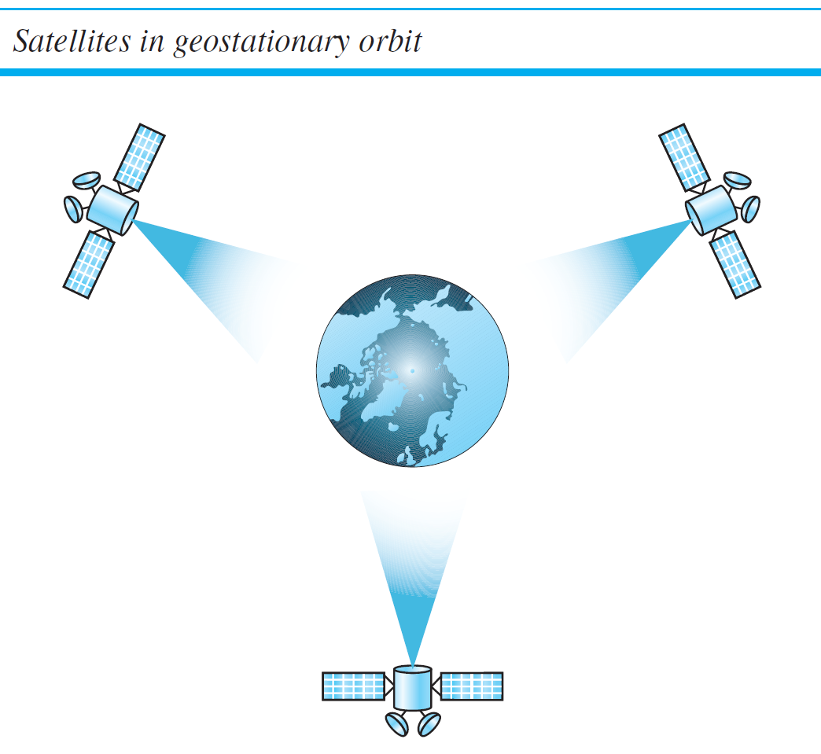
To ensure constant communication, the satellite must move at
the same speed as the Earth so that it seems to remain fixed above a certain spot. Such
satellites are called geostationary.
The view is from the North Pole

Slide 11
MEO Satellites
Medium-Earth-orbit (MEO) satellites are positioned between the two Van Allen belts.
A satellite at this orbit takes approximately 6 to 8 hours to circle the Earth.
GPS - Global Positioning System

Slide 12
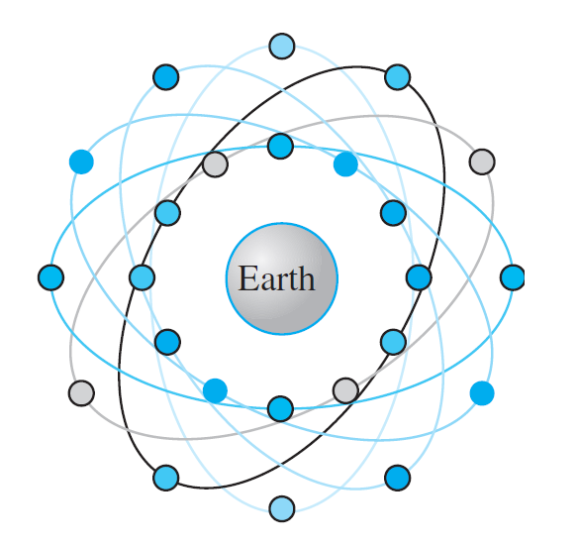
One example of a MEO satellite system is the Global Positioning System (GPS), contracted and operated by the U.S. Department of Defense, orbiting at an altitude about 18,000 km (11,000 mi) above the Earth.
The system consists of 24 satellites and is used for land, sea, and air navigation to provide time and location for vehicles and ships.
GPS uses 24 satellites in six orbits
The orbits and the locations of the satellites in each orbit are designed in such a way that, at any time, four satellites are visible from any point on Earth.
A GPS receiver has an almanac (ref book) that tells the current position of each satellite.

Slide 13
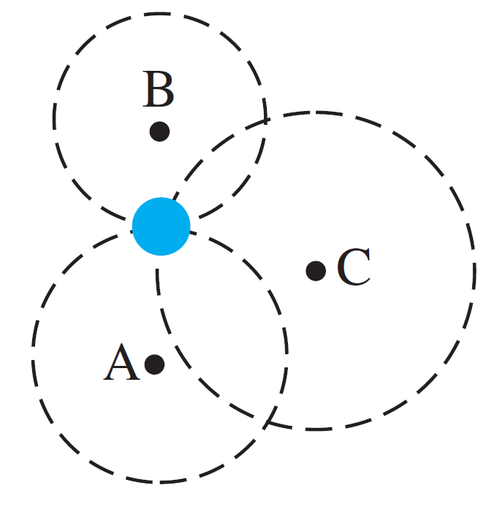
Global Positioning System
Trilateration:
GPS is based on a principle called trilateration
Trilateration is a mathematical technique that uses the distance from at least three known points to determine the location of an unknown point
The terms trilateration and triangulation are normally used interchangeably.
We use the word trilateration, which means using three distances, instead of triangulation, which may mean using three angles.

Slide 14
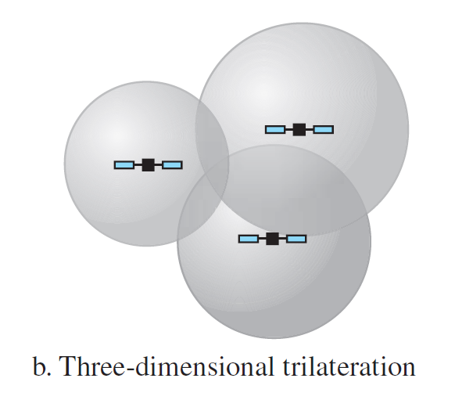
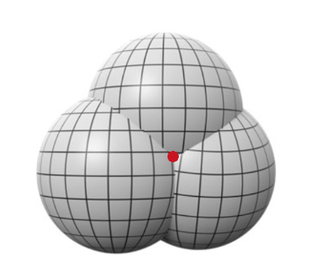
We need at least four spheres to find our exact position in space (longitude, latitude, and altitude).

Slide 15
Measuring the distance:
Measuring the distance is done using a principle called one-way ranging.
Assume that all GPS satellites and the receiver on the Earth are synchronized.
Each of 24 satellites synchronously transmits a complex signal, each satellite’s signal having a unique pattern.
The computer on the receiver measures the delay between the signals from the satellites and its copy of the signals to determine the distances to the satellites

Slide 16
Synchronization
Assumption that the satellites’ clocks are synchronized with each other and with the receiver’s clock.
Satellites use atomic clocks, which are precise and can function synchronously with each other
an atomic clock costs more than $50,000
The receiver’s clock, however, is a normal quartz clock

Slide 17
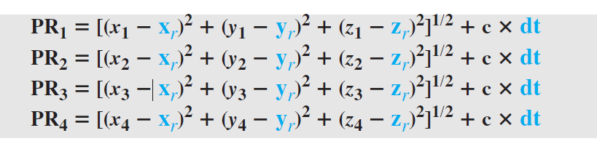
Finding four unknowns: the x_{r}, y_{r}, z_{r} coordinates of the receiver, and common clock offset dt.
Application of GPS???

Slide 18
LEO Satellites
Low-Earth-orbit (LEO) satellites have polar orbits.
The altitude is between 500 and 2000 km, with a rotation period of 90 to 120 min.
The footprint normally has a diameter of 8000 km.
Because LEO satellites are close to Earth, the round-trip time propagation delay is normally less than 20 ms, which is acceptable for audio communication.

Slide 19
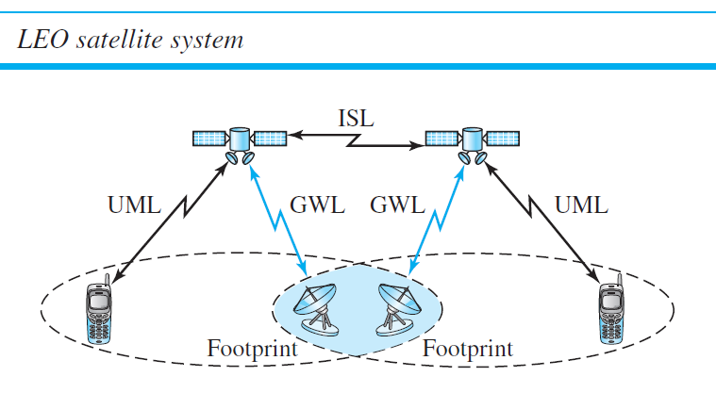
A LEO system is made of a constellation of satellites that work together as a network;
Each satellite acts as a switch.
Satellites that are close to each other are connected through intersatellite links (ISLs).
A mobile system communicates with the satellite through a user mobile link (UML).
A satellite can also communicate with an Earth station (gateway) through a gateway link (GWL).
user mobile link (UML)
gateway link (GWL)
Inter satellite links (ISL).

Slide 20
LEO satellites can be divided into three categories:
little LEOs,
big LEOs, and
broadband LEOs.
The little LEOs operate under 1 GHz.
They are mostly used for low data-rate messaging.
The big LEOs operate between 1 and 3 GHz.
Globalstar is one of the examples of a big LEO satellite system
It uses 48 satellites in 6 polar orbits with
each orbit hosting 8 satellites.
The orbits are located at an altitude of almost 1400 km

Slide 21
Iridium is a global satellite communications company, providing access to voice and data services anywhere on Earth
The Iridium system has 66 satellites divided into 6 orbits, with 11 satellites in each orbit.
The orbits are at an altitude of 750 km.
The satellites in each orbit are separated from one another by approximately 32° of latitude.

Slide 22
The broadband LEOs provide communication similar to fiber-optic networks.
The first broadband LEO system was Teledesic.
Teledesic is a system of satellites that provides fiber-optic-like communication (broadband channels, low error rate,
and low delay).
Its main purpose is to provide broadband Internet access for users all over the world.
It is sometimes called “Internet in the sky.”
The project was started in 1990 by Craig McCaw and Bill Gates; later, other investors joined the consortium.

Slide 23
Starlink is a satellite internet constellation operated by American aerospace company SpaceX providing coverage to over 60 countries,
SpaceX started launching Starlink satellites in 2019.
As of August 2023, it consists of over 5,000 mass-produced small satellites in low Earth orbit (LEO),
Nearly 12,000 satellites are planned to be deployed, with a possible later extension to 42,000

Slide 24
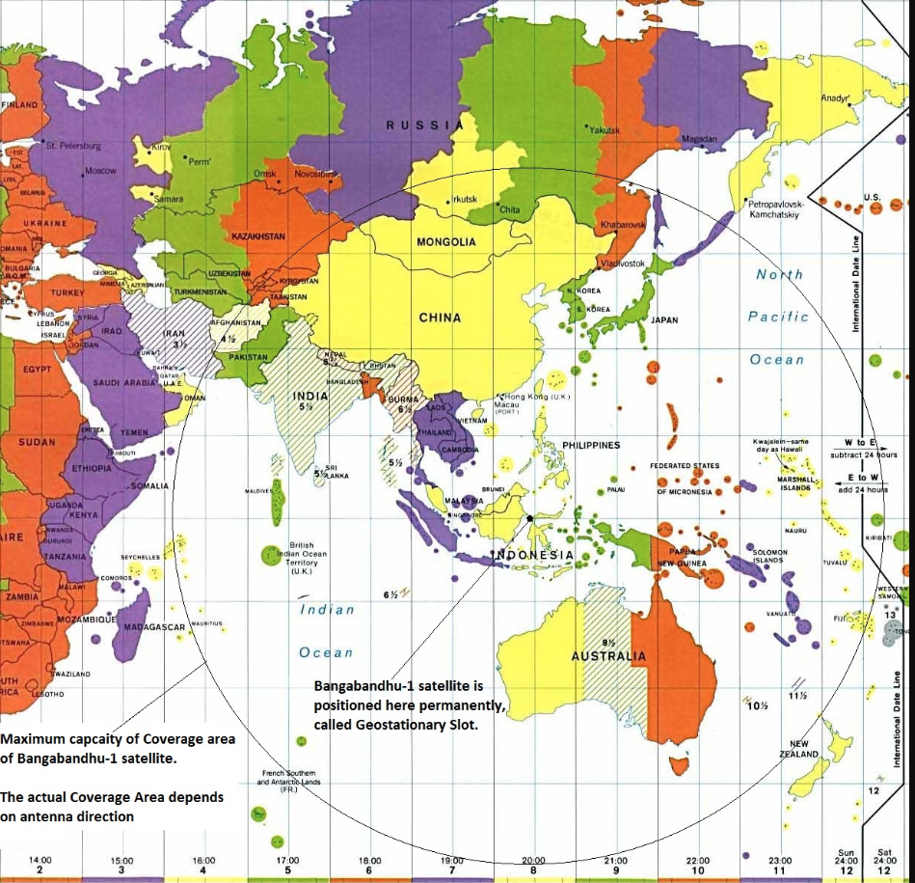
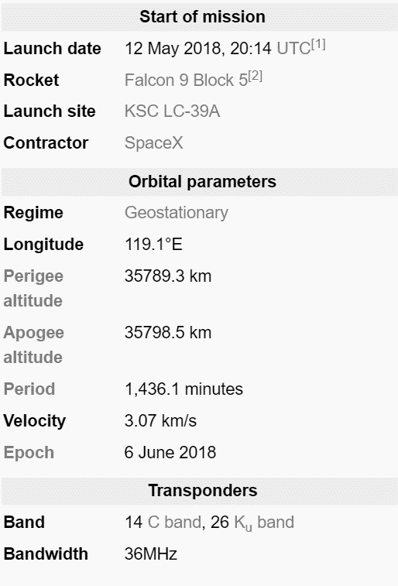

Slide 25
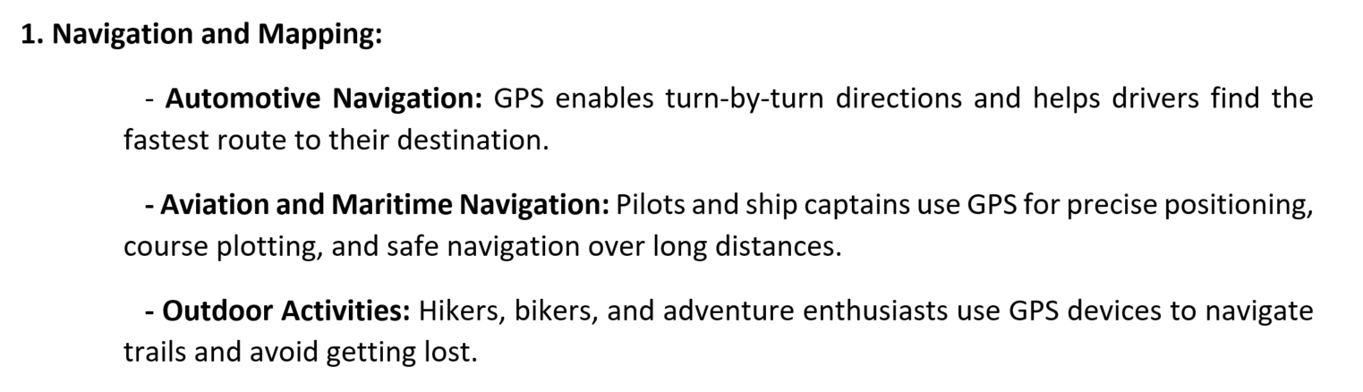
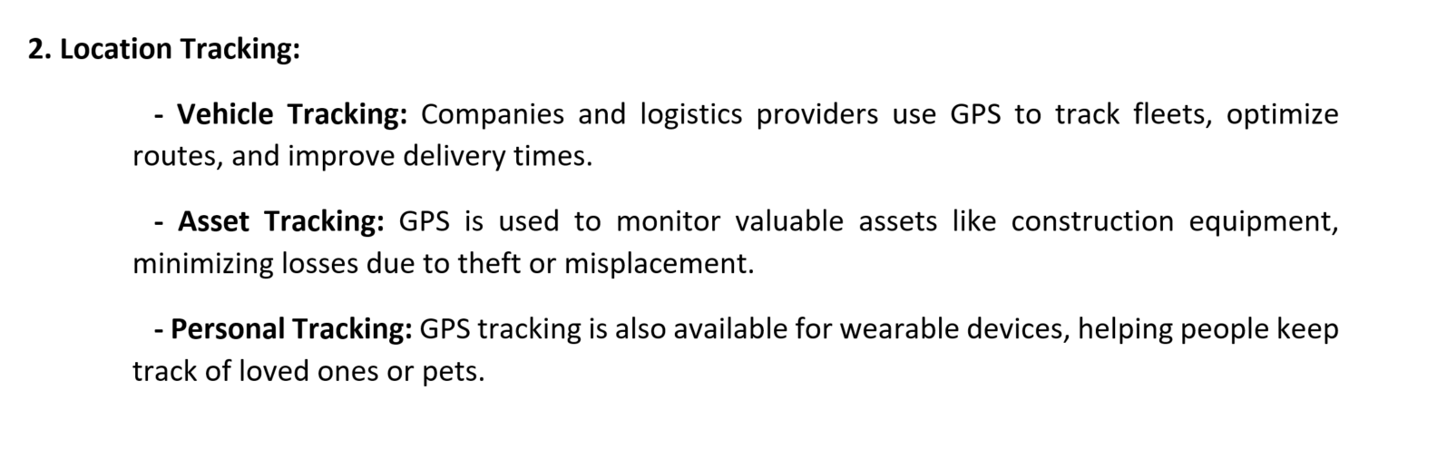

Slide 26
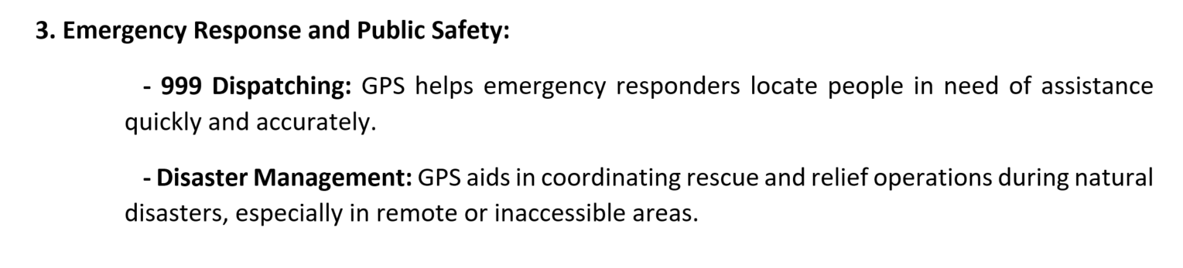
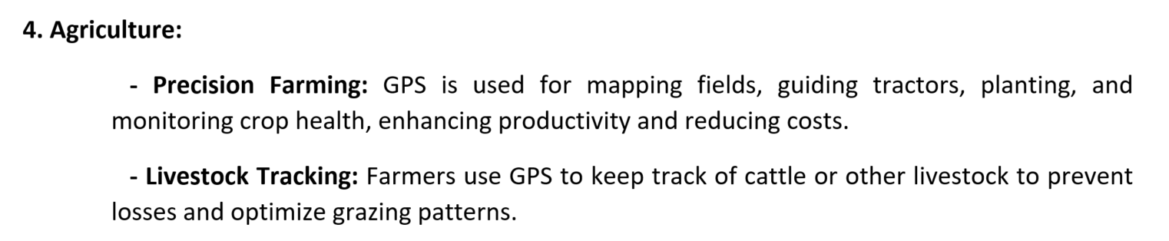
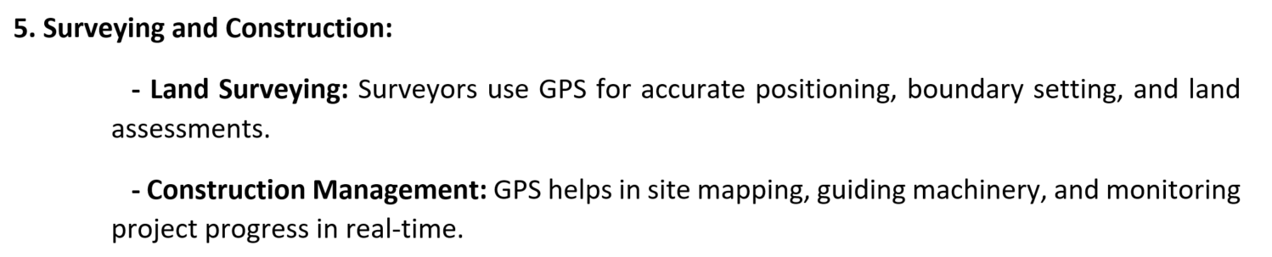

Slide 27
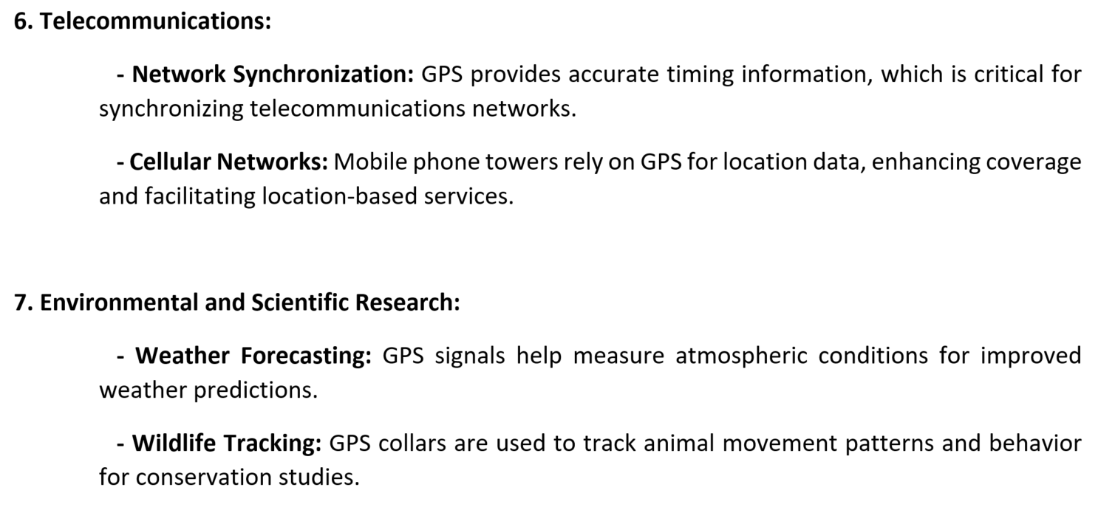
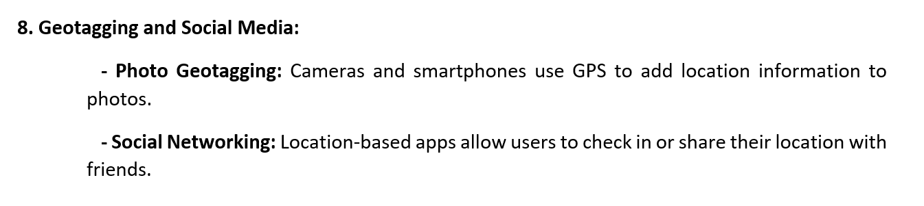

Slide 28
